Slide 1
Standard User: Initiate Contract as
Filed, Received, or Saved As
February, 2013

Slide 2

Learning Objectives
Upon completion of this course you will be able to:
Initiate a new contract using a Filed Contract
Initiate a new contract using a Received Contract
Initiate a new contract using the “Save As” feature

Slide 3
Authoring a Contract
Authoring a contract is the process of initiating and negotiating a contract with a third party electronically in ECM. Contracts can be authored using five different approaches:
Interview: An Interview is like an application “wizard”. You can answer a series of questions and the information is used to automatically create the contract.
Template: A contract can be authored from a template that contains previously defined language.
Filed Contract : Author a Contract from a Non-Revisable File, possibly received from a third party Contract. Filing a contract captures important contract summary data for contracts that were not authored in ECM. Contract in non-revisable formats such as PDF, can be tracked and managed using the features and functions of ECM. A Filed contract often is used for Legacy contracts brought into the system.
Received Contract: Author a Contract from a Revisable File, possibly received from a third party. Contracts can be authored using MS Word documents. The Word documents may be received from third party partners.
Save As: Author from a Clone of a previously created contract that was saved using the Save As feature.

Slide 4
Authoring a Contract from Non-Revisable Format

Slide 5
Authoring Contract from Non-Revisable Format
You may receive contract language electronically that is in a non-revisable format such as a PDF document.
You can include these documents in ECM and use the system’s features and functions to track the contract.
These non-revisable contracts are called “Filed” Contracts.
Also, this feature is extremely useful for managing legacy contracts.
  Legacy contracts generally are in a non-revisable format and merely need to be tracked until they expire or are terminated.
  Entering them as Filed Contracts automates the management process for these contracts.

Slide 6
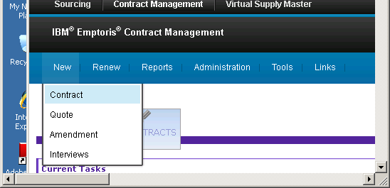
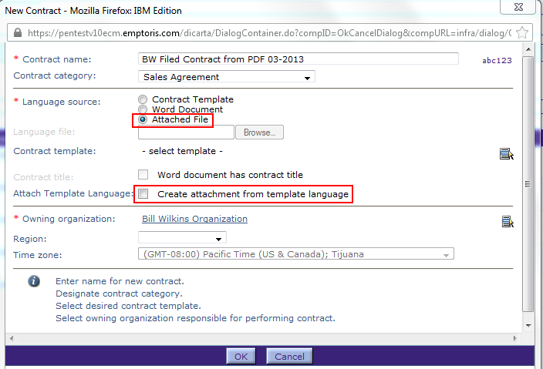
Initiate New Contract from Filed Contract
Select New > Contract from the top menu bar.
  The New Contract Dialog box is displayed
Enter the Contract Name.
Select the Contract Category.
Select the Language source as
Attached File. The “Language
File” field becomes disabled.
If you specify “Attach Template
Language”, you must select a
Contract Template, and its contents
become the Contract Language.
(Special Legacy or Filed Contract
templates are used to include
tracking terms that are appropriate
to these non-revisable formats.)
Otherwise, attach the language later,
in the Language tab. (You can still
choose a Contract Template at creation,
but it does not provide the contract language.)

Slide 7
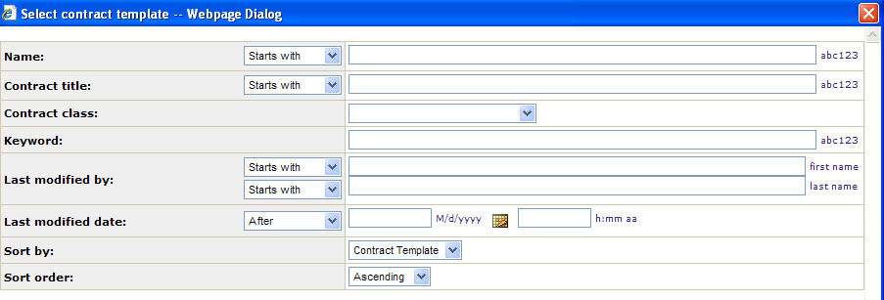
Search Contract Templates
Enter as much information about the contract template as you would like, or leave all the fields blank to display a list of all templates.
Click Find

Slide 8
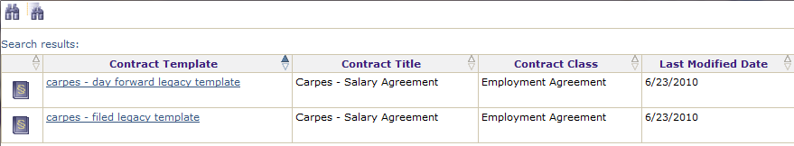
Search Contract Templates, cont .
Navigate to the page that contains the contract template.
Click on the hyperlink name of the template
The template is added to the New Contract dialog box.

Slide 9
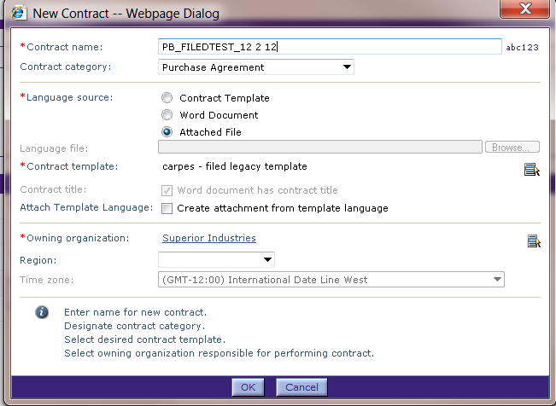
New Contract Dialog Box
The contract template has been selected.
Verify the Owning Organization and Time Zone.
Click OK when done.

Slide 10
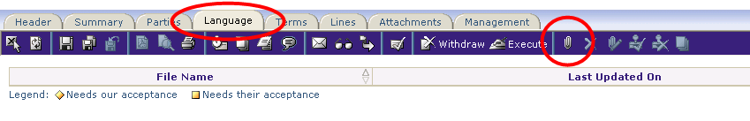
Contract Editor
The Contract opens in the Contract Editor window with the Header tab displayed.
From here you can edit the Header and Parties information, as appropriate.
Click on the Language Tab.
Click the Attach Language icon (small paper clip) on the main, blue toolbar. The Attach Language dialog box is displayed (unless a language attachment has already been added; in that case, if the language attachment is wrong, you can delete it and add another, or update it with the correct attachment).

Slide 11
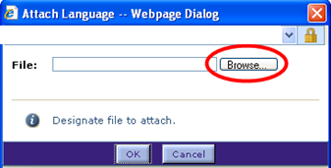
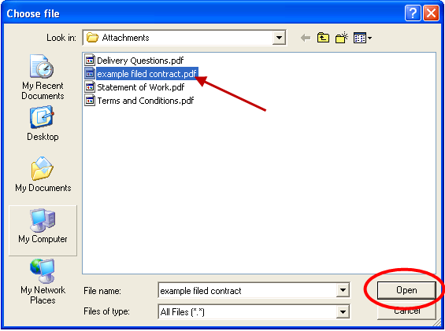
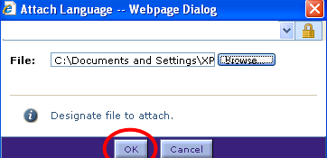
Attach Language Dialog Box
Click Browse button to select the file.
Navigate to the folder and file.
Click to highlight the file name.
Click Open to select this highlighted file.
The file name is added to the Attach
Language dialog box. Click OK when done.

Slide 12
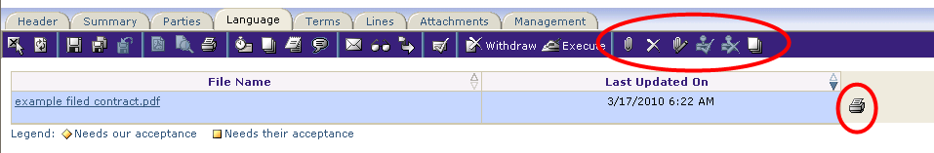
Language Tab
The selected file is added as the Language file, and its name is displayed on the Language tab. There can be only one such file.
The icons on the far right of the main, blue toolbar can be used to:
  Delete the attached language
  Update the attached language (change to a different language file)
  Compare revisions to the attached language
Click the printer icon to print a copy of the attached file, if desired.
Click the file name hyperlink to display the attached file.

Slide 13
Authoring a Received Contract

Slide 14

Authoring Contract from Revisable Format
You may receive contract language electronically that is in a revisable Microsoft® Word format.
Typically this is from the other party, so it is often termed OPP (Other People's Paper).
You can integrate these documents into ECM as if they were authored from a contract template. However, it is cumbersome and thus much less common than Filed contracts.
These revisable MS Word document contracts are called “Received” Contracts.

Slide 15
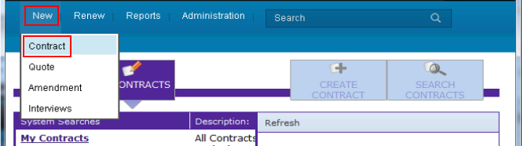
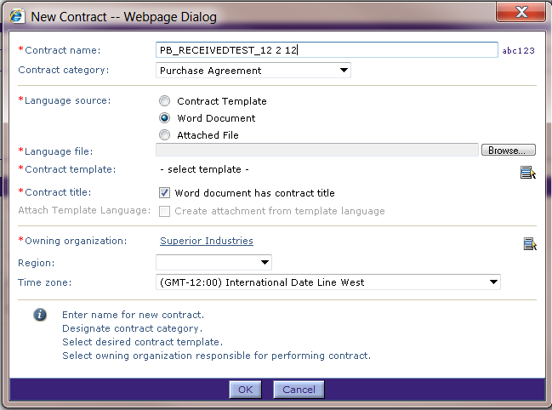
Initiate a Received Contract
Select New > Contract from the top menu bar.
  The New Contract Dialog box is displayed
Enter the Contract Name.
Select the Contract Category.
Select the Language source as
Word Document.
Click the Browse button to select
the Word document language file.
  The Choose File dialog box is
  displayed.

Slide 16
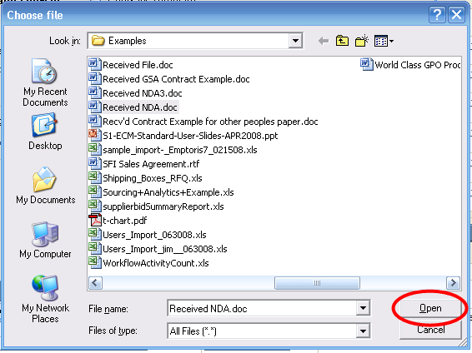
Choose File Dialog Box
Navigate to the folder and file; highlight the file name to select it.
Click Open to select the highlighted file.
  The file name is added to the Language file field of the New Contract dialog box. (Note: this screen shows a .doc file being selected, but only .docx is supported now.)

Slide 17
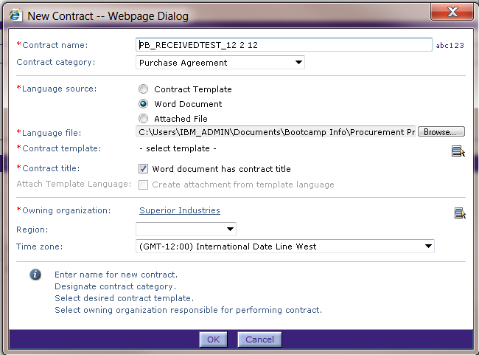
New Contract Dialog Box
Select a contract template to associate with this contract using the Select icon.
  The template may include Tracking Terms for received contracts and clauses that can be ‘mapped’ to this contract, or may provide alternate clauses to substitute within this document. More about this on a later slide.
If the MS Word file has a valid contract title, click the box in Contract Title field.
Click OK when done.
NOTE: ECM only supports
Office 2007 or later (.docx)
documents.
Make sure your Word
document is saved in
the .docx format, or the
system will not upload it.

Slide 18
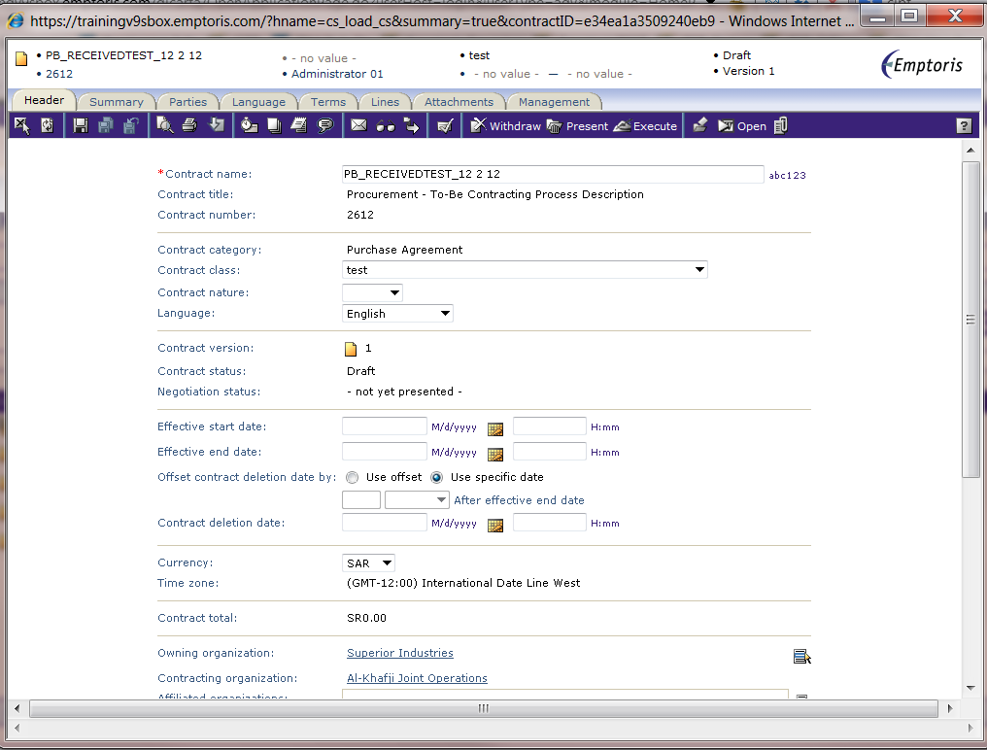
Contract Editor
The contract is created and the Contract Editor is displayed.

Slide 19
Template and Language Considerations
Question: Why specify a Contract Template for a contract from another party? It will not match a Contract Template in your ECM system, unless you create such a template (which only makes sense if you will get a high volume of near-identical contracts from outside).
  The short answer is that you can massage the document to more closely match an existing template.
The contents of the first line of the document can be used as the Contract Title (or it can come from the template)
In the Contract Editor, on the Language tab you can see that the contract is automatically treated as having one clause, starting at the beginning of the document, plus 0-n additional clauses, all beginning at the Section Breaks (either Continuous or Next Page) in the document.

Slide 20
Template and Language Considerations, cont.
On the Language tab, in the ECM pane on the right, you can see the Clause Checklist and the Term Checklist tabs, which list the clauses and tabs in the Contract Template you chose.
To break up the contract into clauses that match the clauses in the Contract Template:
  Position the cursor in the contract at the point where you want a new clause to begin, right click, and choose Split Clause.
  The above creates a new clause. Click in that new clause, and in the Manage Clause menu, choose Map Clause to Template. This takes you to a search for Clause Templates. Use the Clause Checklist to determine the name of the clause to search for.
  After you select the clause, it is mapped to the contract and will have an asterisk (*) beside it in the Clause Checklist on the right.
Similarly, you can insert Terms to correspond to Terms in the template.

Slide 21
Template and Language Considerations, cont.
As an alternative to splitting up the contract on the Language tab, you can instead add breaks into the contract document before basing a new Received Contract on it. To do this:
  Add breaks at the appropriate spots. [Word 2007] Page Layout > Breaks > Section Breaks > (either Next Page or Continuous)
  Now ECM will recognize each break as the start of a new clause.
  Map and insert Terms as above, then set Term values via Terms tab.

Slide 22
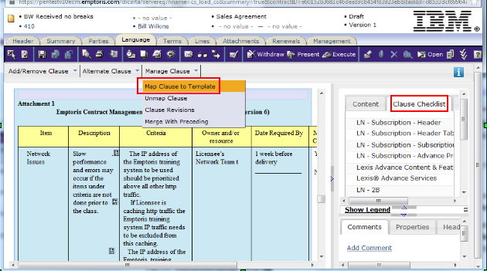
Template and Language Considerations, cont.
In the following, we've split the contract at the start of Attachment 1, and are about to click on Map Clause to Template. We can then use the list of clauses in the Clause Checklist to find which clause template to search for, and map that to our new Attachment 1 clause.

Slide 23
Authoring using the “Save As” feature

Slide 24
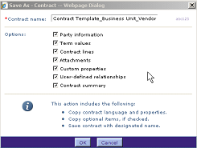

“Save As” Feature
Search for and open the contract you want to copy.
Click the Save As icon located on the left side of the toolbar.
You will presented with the Save As - Contract Dialog box.
  Mark the options to specify which attributes of the contract to copy
  Change the contract name,
  if desired
  Click OK.
The new contract will be presented for you to complete.
Notice that in the Header, the “From” indicates the contract that was utilized as a starting point.
Notes:
NOTE: The “save as” feature is not yet functional. We are presenting the information here for future use.

Slide 25

Questions?

